Slide 1
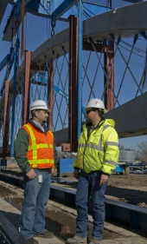
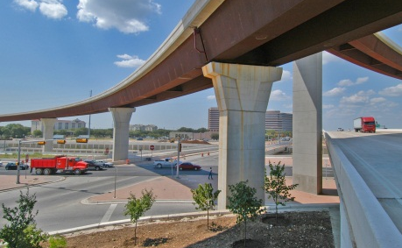
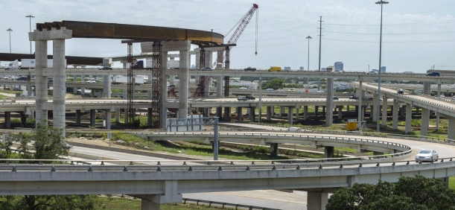
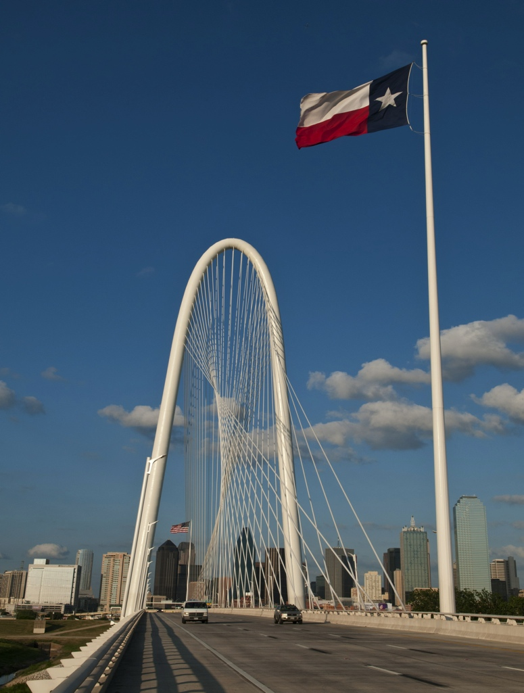
Guardrail End Treatment
Data Collection

Slide 2
Purpose
Collect GPS locations and guardrail end treatment types (along on-system roadways) in order to determine the total number of each treatment type.
Establish an inventory for long-term management of this asset.

Slide 3
Project Roles
TPP
Workspace, Data Collection Framework, Map, SharePoint
District Maintenance Section Personnel
Data Collection and Reporting
Design and Maintenance Divisions
Subject Matter Experts, Organization, Support

Slide 4
End Treatment Examples
ET PLUS
X-LITE
ET 2000
Turndown

Slide 5
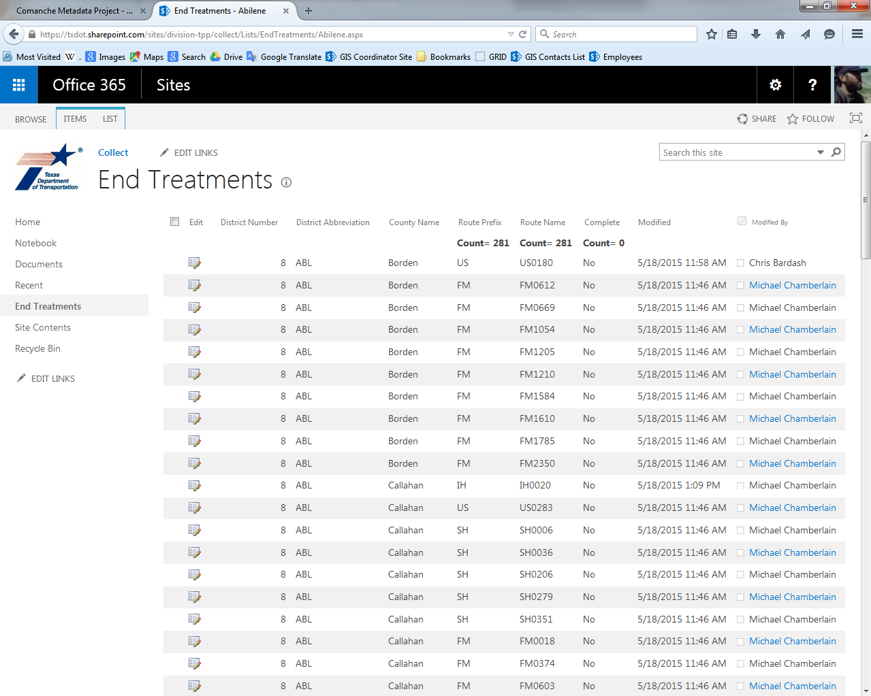
SharePoint Route Planning & Tracking Site

Slide 6
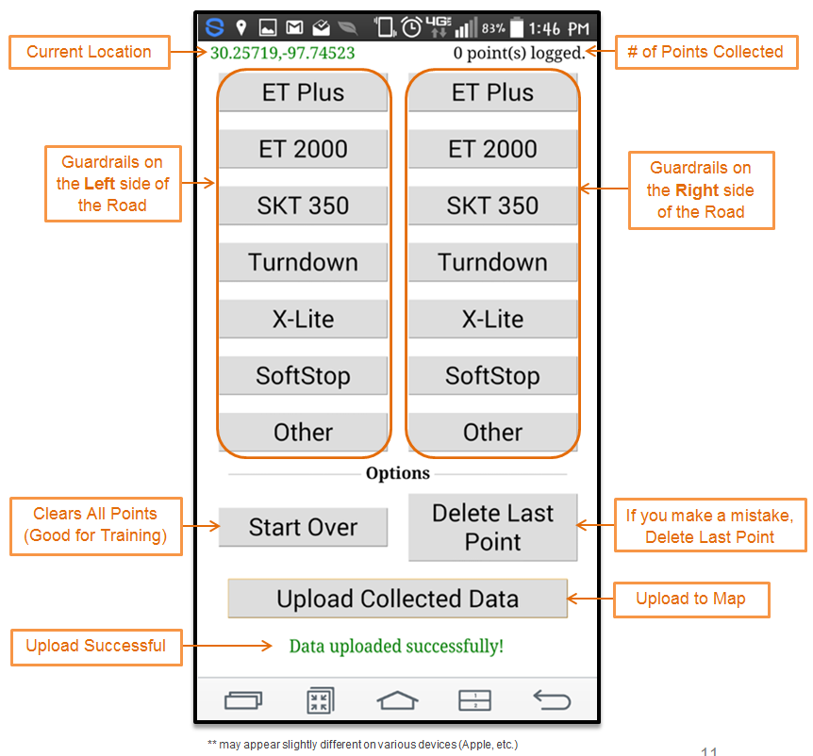
Smartphone Data Collection
http://www.txdot.gov/apps/statewide_mapping/collect/index. html

Slide 7
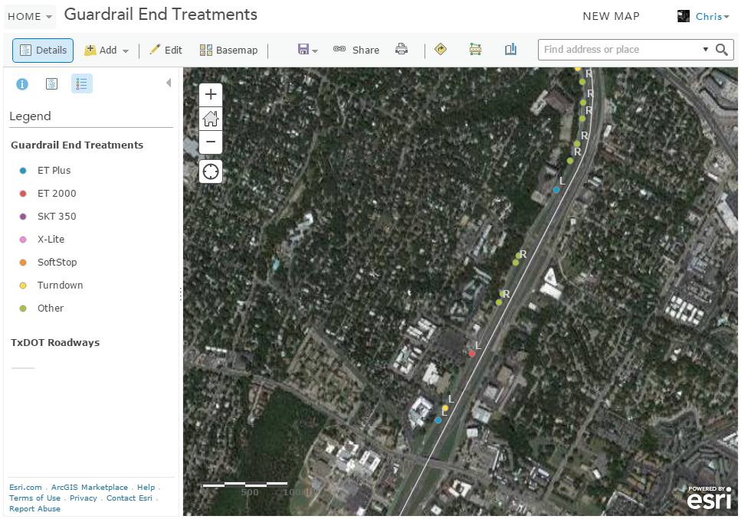
ArcGIS Online Map – Real Time Quality Control
http://arcg.is/1F9mgwY

Slide 8
Results
General Statistics
Start Date: May 19th
End Date: June 30th
Project Duration: 30 working days
Average Collection Speed: 35 mph
Average Accuracy Rating: 26 ft
Most common Device: iPhone
Most GET points collected in a day: 10,801 (June 9th)
Device | # GETs Collected
Android | 13,557
iPad | 18,155
iPhone | 102,280

Slide 9
District Type Totals Summary
District | ETPLUS | ET2000 | OTHER | SKT350 | SOFTSTOP | TURNDOWN | XLITE | TOTAL
Abilene | 521 | 260 | 344 | 1,355 | 2 | 2,578 | 4 | 5,064
Amarillo | 681 | 660 | 44 | 273 | 3 | 1,623 | 12 | 3,296
Atlanta | 1,933 | 254 | 179 | 761 | 1 | 1,349 | 2 | 4,479
Austin | 3,630 | 355 | 1,182 | 2,947 | 8 | 4,154 | 45 | 12,321
Beaumont | 1,437 | 477 | 136 | 362 | 0 | 1,178 | 6 | 3,596
Brownwood | 577 | 86 | 44 | 574 | 1 | 1,677 | 12 | 2,971
Bryan | 1,688 | 504 | 94 | 484 | 0 | 1,985 | 57 | 4,812
Childress | 531 | 203 | 386 | 267 | 0 | 659 | 0 | 2,046
Corpus Christi | 1,469 | 397 | 333 | 730 | 3 | 1,551 | 2 | 4,485
Dallas | 5,409 | 1,792 | 888 | 349 | 22 | 3,846 | 151 | 12,457
El Paso | 1,022 | 300 | 454 | 886 | 239 | 1,650 | 26 | 4,577
Fort Worth | 3,198 | 654 | 242 | 280 | 11 | 4,225 | 154 | 8,764
Houston | 4,051 | 1,194 | 322 | 848 | 2 | 2,525 | 52 | 8,994
Laredo | 783 | 389 | 77 | 1,118 | 2 | 1,204 | 1 | 3,574
Lubbock | 320 | 590 | 151 | 538 | 0 | 723 | 30 | 2,352
Lufkin | 2,331 | 75 | 118 | 346 | 36 | 982 | 57 | 3,945
Odessa | 164 | 354 | 272 | 559 | 1 | 1,397 | 6 | 2,753
Paris | 1,851 | 645 | 398 | 738 | 5 | 2,285 | 47 | 5,969
Pharr | 1,063 | 435 | 79 | 405 | 2 | 774 | 9 | 2,767
San Angelo | 922 | 278 | 57 | 693 | 2 | 1,999 | 14 | 3,965
San Antonio | 2,948 | 1,157 | 428 | 1,905 | 3 | 6,119 | 17 | 12,577
Tyler | 1,966 | 307 | 248 | 285 | 5 | 1,742 | 13 | 4,566
Waco | 2,789 | 569 | 481 | 633 | 8 | 1,062 | 42 | 5,584
Wichita Falls | 880 | 155 | 207 | 608 | 1 | 1,514 | 69 | 3,434
Yoakum | 1,451 | 632 | 251 | 573 | 5 | 1,706 | 26 | 4,644
Statewide | 43,615 | 12,722 | 7,415 | 18,517 | 362 | 50,507 | 854 | 133,992

Slide 10
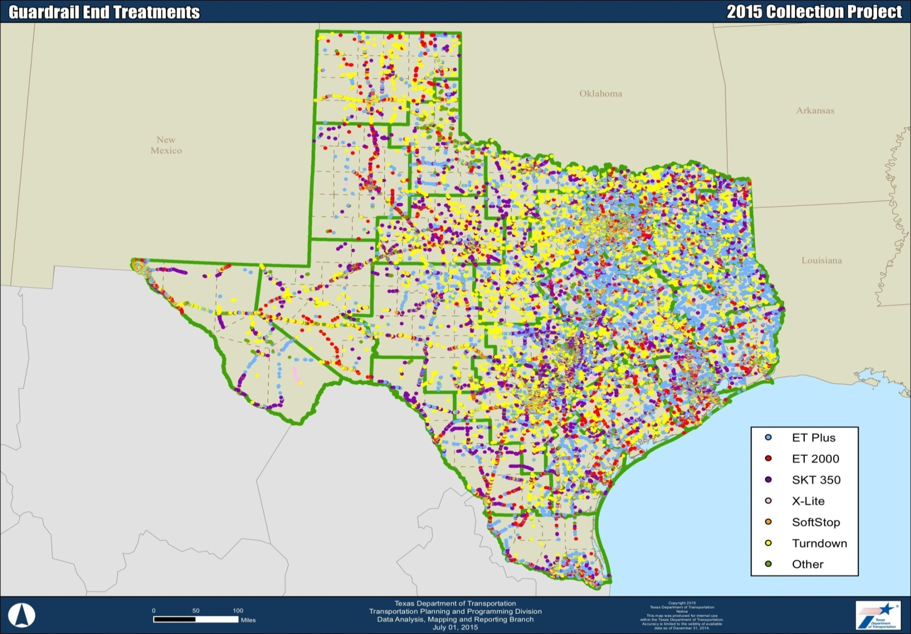
Results Map

Slide 11
TPP Team
Transportation Planning and Programming Team
Michael Chamberlain – Data Management Section Director
Mike Zugelder – GIS and Data Analysis Branch Manager
Adam Breznicky – GIS Analyst II
Chris Bardash – GIS Analyst II

